Slide 1
Ethernet Over PCI Express Presented by Kallol Biswas
NucleoDyne Systems, Inc. 19925 Stevens Creek Blvd Cupertino, CA

Slide 2
Outline of Today’s Presentation
Overview
Highlights of PCI Express Protocol
System to System communication using PCIe ( PCI Express protocol )
Advantages and Issues
Application Areas

Slide 3
Overview
Traditional Use model
Ethernet devices connect two or more
computer systems.
PCI Express bus links motherboard
mounted peripherals or add-in devices.
New Use Model
PCI Express switch connects two or more
computer systems at system bus level.

Slide 4
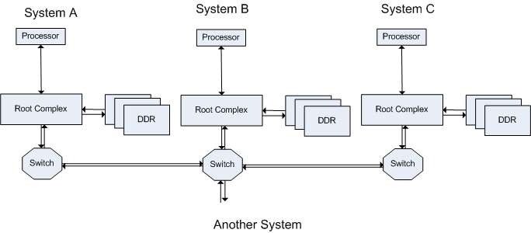
Multiple Computer Systems Connected through PCIe switch
Remote system’s memory is available to local system for load/store CPU instructions and DMA operations.

Slide 5
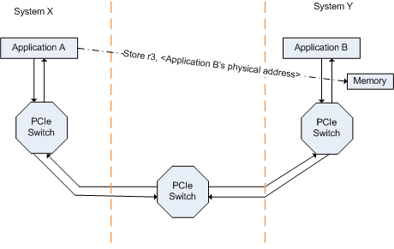
New Use Model A process writes to a remote process’ address space

Slide 6
Inter process communication schemes
Direct Communication
One process read/writes information to
remote process on a different system
No socket API is necessary
Low latency data access
TCP/IP based Communication
Ethernet frames are sent over PCIe Bus
Observation
Low Latency and High Throughput
Lower Power consumption and Low cost

Slide 7
Highlights of PCI Express Protocol
Packet based Serial bus protocol
Point to Point, bidirectional
Effective data rate on each lane 2, 4 or 8 gbps
Layer architecture
Software, Transaction, Data Link,
Physical
Path based routing, globally addressable fabric
QoS support
Universal acceptance

Slide 8
System to System Communication

Slide 9
Two Node Communication in PIO Mode
Store r3, <address in System B’s DDR>
System A
System B
Processor
Processor
FSB
FSB
Root Complex
Root Complex
DDR3
DDR3
TLP with modified header
Switch
ACK/NACK DLLP
Switch
Start
Seq#
Header
Content of r3
ECRC
LCRC
End

Slide 10
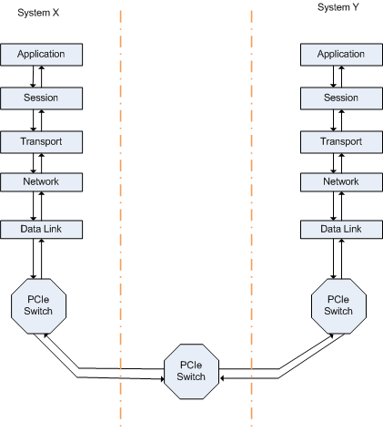
System to System Communication Ethernet Over PCI Express

Slide 11
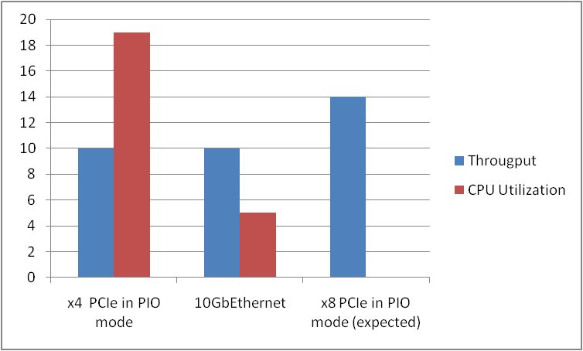
Test Results Throughput & CPU Utilization

Slide 12
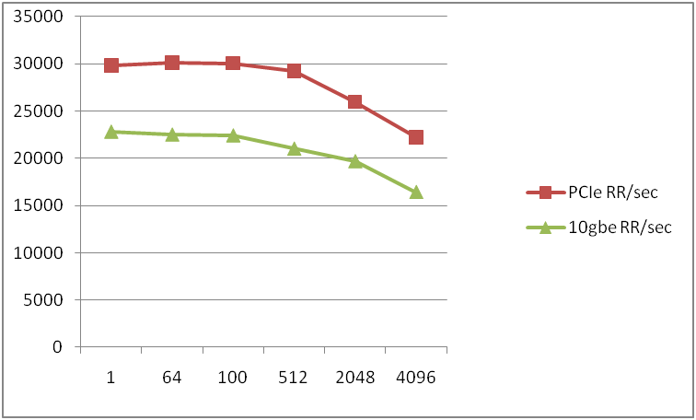
Test Result - Latency

Slide 13
Advantages
Lower Power Consumption
A 16 lane Gen2 switch consumes ~2.5W
Lower Cost
Cost is around $1 per len, x8 lane device costs ~$8
Savings in ecosystem
Lower cost for each components, clocks, connectors, cables and test equipments
Lower latency and higher throughput

Slide 14
Issues
Length Limitation
Max External cable length is approx 5m, with optical connector max length upto 100m
Maximum number of nodes supported in
a fabric
Max number of Bus x device x func
256 x 32 x 8 = 65536 nodes, Gen3 supports much larger number

Slide 15
Application Areas
Replacement of parallel buses like VME
(Versa Modular Eurocard bus) 9.97 Gbps over x4 PCIe switch vs 2.56 Gbps
Multi-node cluster development
NVRAM mirroring
In trading systems or banking industry

Slide 16
www.nucleodyne.com
US System software services company
Low Level Kernel & system software
Low level device drivers for storage and
communication protocols
End to end system development
processor customization
system board development
OS port or write new OS
custom application development

Slide 17
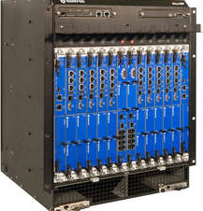
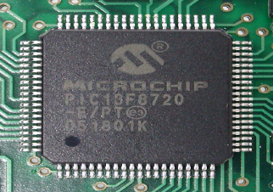
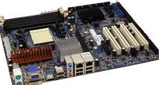
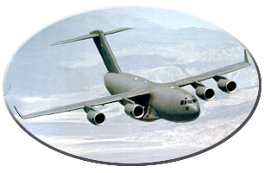
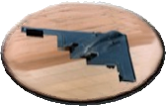

Thank You
NucleoDyne Systems, Inc. 19925 Stevens Creek Blvd, Cupertino, CA

